Slide 1
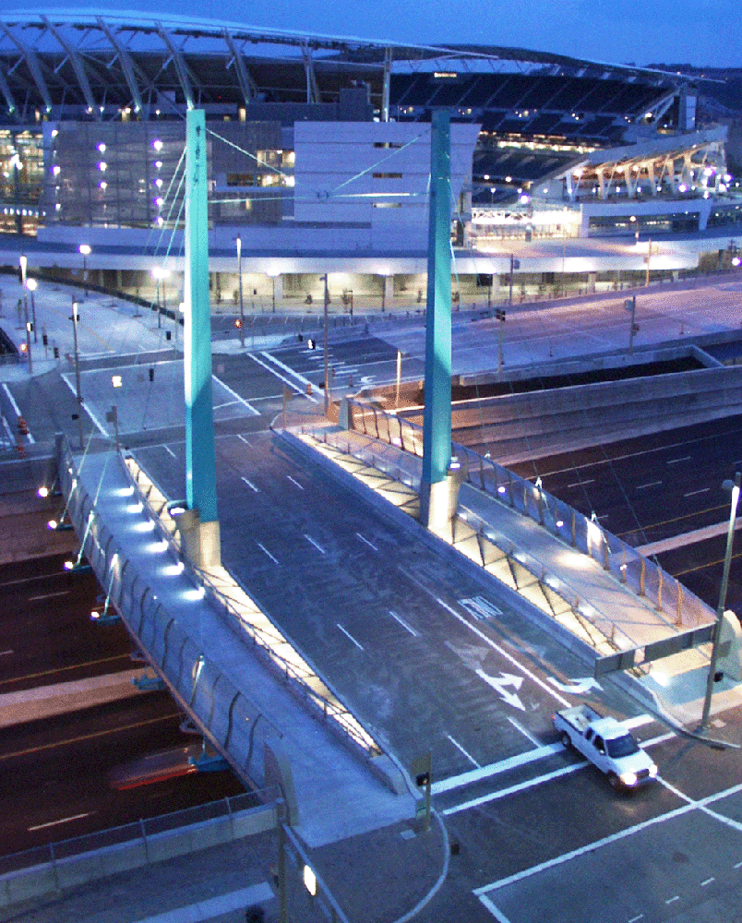
FORT WASHINGTON WAY 2000 Urban Design
PROJECT DESIGN MANUAL
Examined urban design in each aspect of the project
Produced in conjunction with overall civil engineering design manual
Controlled the overall project aesthetics
Captured best value for dollars spent
Notes:
The first step in this undertaking was the development of project design manual so that urban design of the project would not be an afterthought, but would be examined during each step of design and construction.

Slide 2
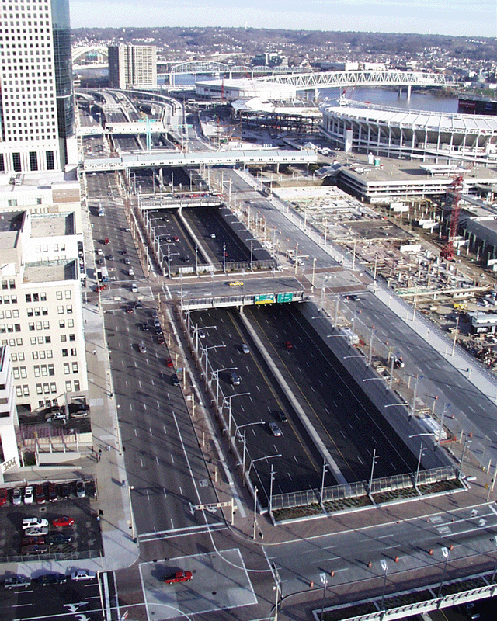
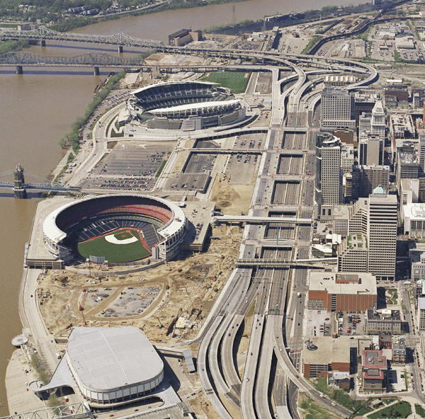
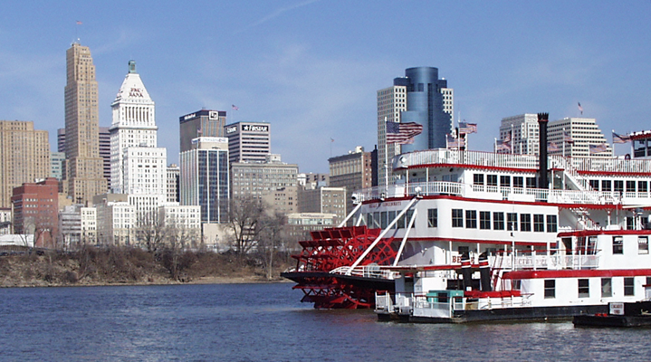
FORT WASHINGTON WAY 2000 Urban Design
Linked the riverfront to downtown by extending the street grid over the highway.
Notes:
Project planners also were forward thinking throughout the design process. One example -- instead of building the new Second Street on a mound of fill, planners instead built the roadway on structure, which enabled the Riverfront Transit Center to be constructed underneath.

Slide 3
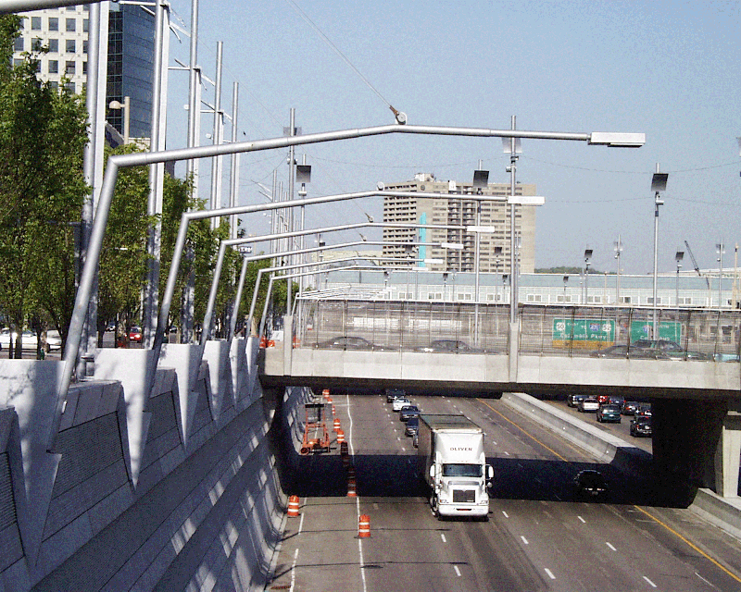
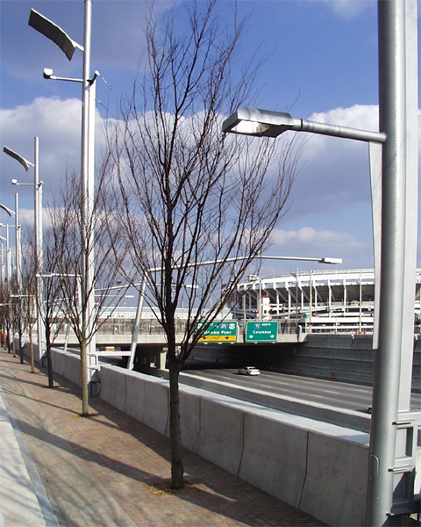
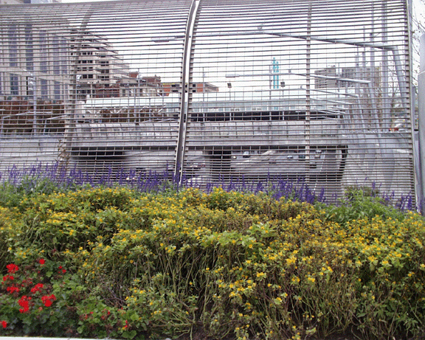
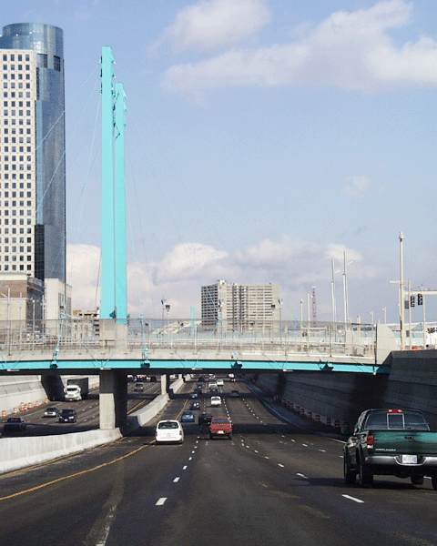
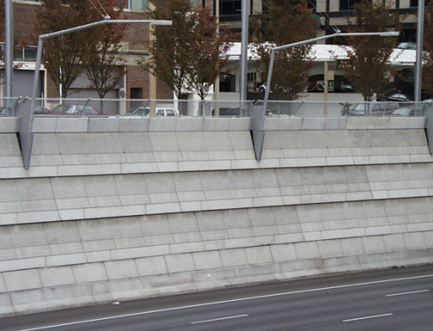
FORT WASHINGTON WAY 2000 Urban Design
HIGH QUALITY AND VALUE-MAXIMUM IMPACT
Custom made pre-cast panels
Unique lighting using standard fixtures
Decorative vandal screens
Multi-colored bridge beams
Notes:
The urban design features used throughout the project were of the highest quality.
Instead of flat concrete retaining walls lining Fort Washington Way , the design manual called for pre-cast, decorative concrete panels to be erected the entire length of the trench.
Instead of standard run-of-the-mill streetlights, designers instead selected low-cost, low-maintenance; high-intensity street lights which would illuminate not only the roadway, but the adjacent streets as well.
Even the colors of the paint selected for the bridge structures were cutting edge – no standard gray here – instead periwinkle and teal were chosen.

Slide 4
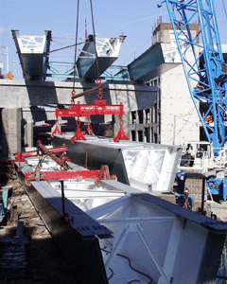
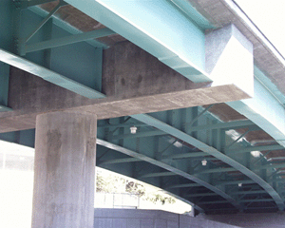
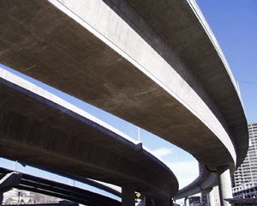
FORT WASHINGTON WAY 2000 Innovative Bridge Types
Firsts in Ohio:
Steel Box Girder
Cast-in-Place Box Girder
Concrete Integral Piers

Slide 5
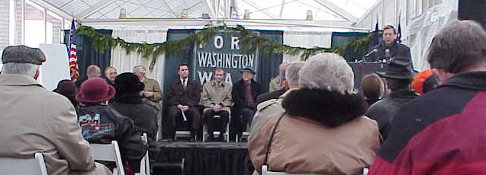
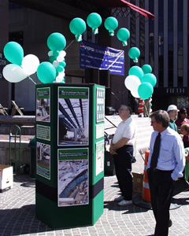
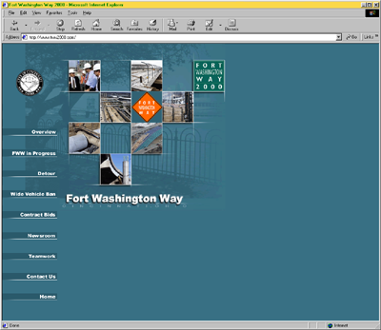
FORT WASHINGTON WAY 2000 Public Involvement
COMPREHENSIVE OUTREACH
Established graphics standards for all materials
Revitalized existing regional coordination committees
“Connection to the Future” newsletter distributed to project stakeholders
http://www.fww2000.com/
Notes:
More than 200,000 Motorist and Pedestrian Detour Maps distributed.
More than 300 community meetings.
‘Connection to the Future’ newsletter distributed to project stakeholders.

Slide 6
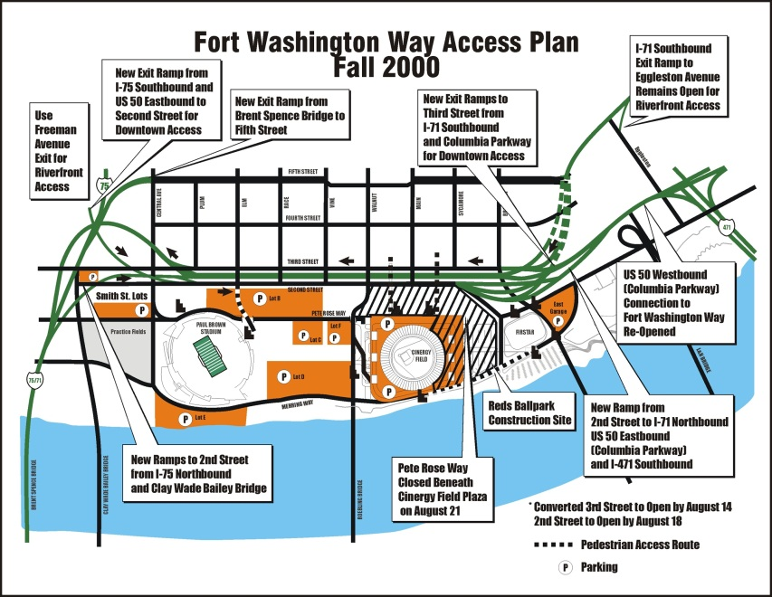
FORT WASHINGTON WAY 2000 Public Involvement
Outreach (continued)
Over 200 meetings held prior to start of construction to establish dialogue
More than 400 community meetings held throughout project construction to maintain contact
Distributed more than 200,000 motorist and pedestrian detour maps

Slide 7
FORT WASHINGTON WAY 2000 Public Involvement
OUTREACH (continued)
Regular events to mark significant project milestones and maintain media contact
Regularly scheduled meetings with community support groups
Suggestions and comments taken through telephone, web sites, and e-mail
http://www.fww2000.com/

Slide 8
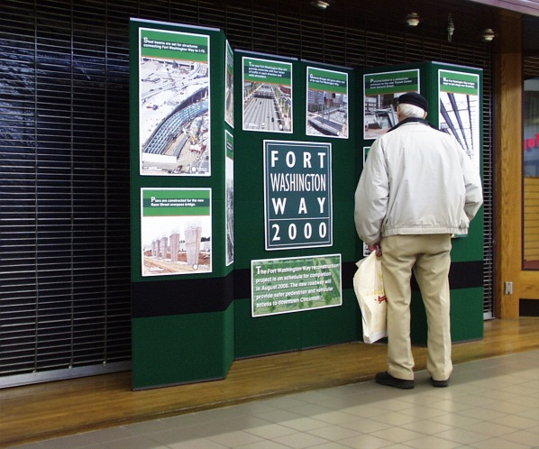
FORT WASHINGTON WAY 2000 Public Involvement
OUTREACH (continued)
Innovative Tools included:
Roving information display
‘Connection to the future’ video
www.FWW2000.com with three live cameras
Interpretive site observation display
Community events
Traffic alert e-mail messages
Notes:
Roving Information Display which was exhibited at nearly 40 locations.
‘Connection to the Future’ Video was distributed to video rental stores and libraries across the entire region.
The Web site, www.FWW2000.com- was accessed by thousands of community members.
The Observation Display on the Walnut Street pedestrian bridge, over the Fort Washington Way mainline.
Community events such as the ‘Halfway There’ event on Fountain Square and public ribbon cuttings, as the project neared completion.

Slide 9
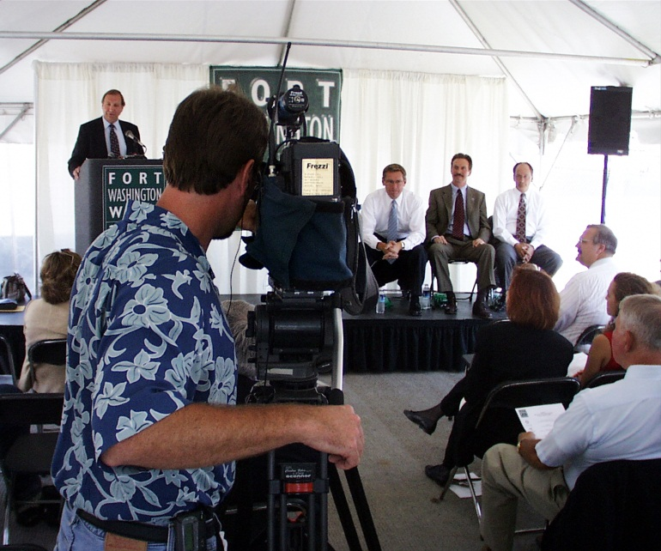
FORT WASHINGTON WAY 2000 Public Involvement
AGGRESSIVE
MEDIA RELATIONS
Daily traffic updates
Regular updates and tours of project site
Open lines of communication
Regular feedback sessions with police, fire and traffic helicopters
Notes:
Traffic alert e-mail distribution.
Regular updates and tours of project site.
Consistent open lines of communication.

Slide 10
FORT WASHINGTON WAY 2000 Awards
ACEC- American Council of Engineering Companies of Ohio - 2002 Engineering Excellence Award
CMAA - Construction Management Association of America - 2001 Construction Management Project Achievement Award
ARTBA - American Road & Transportation Builders Association - 2000 PRIDE in Transportation Construction Award -
ASCE Ohio OCEA - American Society of Civil Engineers - Ohio - 2001 Outstanding Civil Engineering Achievement Award
Parsons Brinckerhoff - Project of the Year 2001
SEGD - 2001 Award Outstanding Project from Society of Environmental Graphic Design
Crystal Award for Fort Washington Way “Connection to the Future” Video
ICMA - 2001 International City Council Management Association of America Award
IRF - 2001 IRF Global Road Achievement Award - International Road Federation - Honorable mention

